Slide 1
Dynamic Price Prediction for travel using IBM Watson

Slide 2
Team Details
K Satya Deva Hanumanth Charan 18BEE0140
Ch Vineeth Sai 18BEE0182
S Sudhir Sai 18BEE0184
Siddharth Garg 18BCE0525

Slide 3
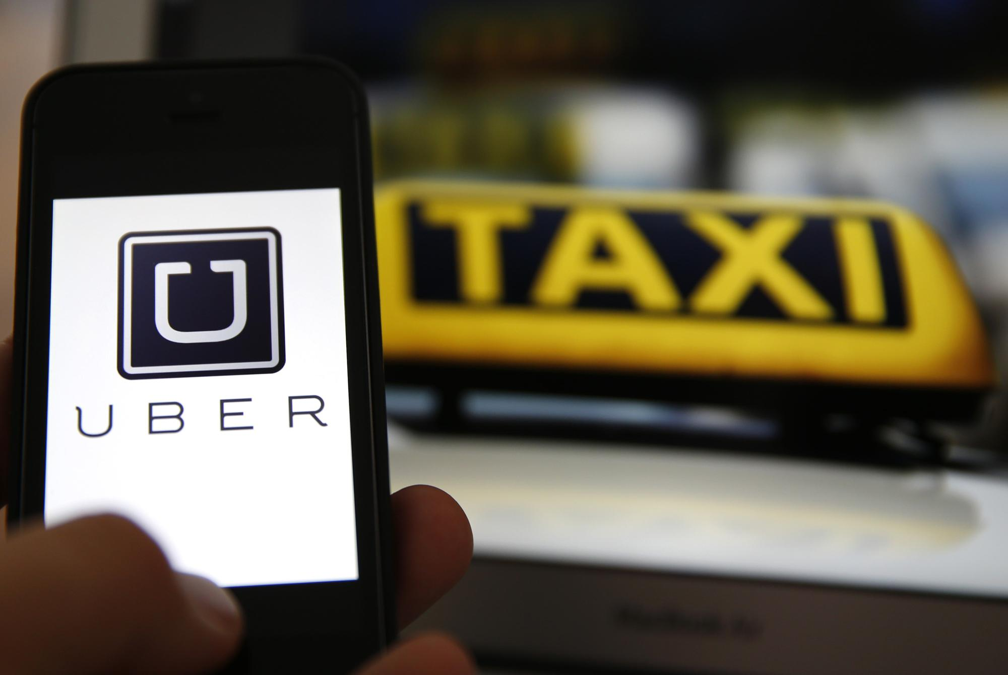
Introduction
Many organizations may not have direct role in transportations but offer related products and services
Dynamic Pricing: Prices of transportation services offered by organizations may vary according to demand and supply and many other reasons. This process of variation in pricing is called Dynamic Pricing.
Two common instances are:
Instance-1: Airlines increase the price of travel during rush hours of the week days and on the week days. This is also called as Peak Pricing
Instance-2: When there is a heavy rain suddenly and people want to use the cab services and in the other end cab services are very low then it’ll become necessary to increase the fare price of the travel. This is also called as Surge Pricing.
This Photo by Unknown Author is licensed under CC BY-NC

Slide 4
Problem Statement
We observed in the previous slide, that dynamic pricing is mandatory in both the instances.
Now, the questions are:
What should be the new fare for travel??
How can we decide the fare price between different routes??
On what basis, we decide the fare??

Slide 5
Advantages and Disadvantages
Higher Profit & Sales
Adjusting to the Competition
Flexibility
Better Inventory Management
Customer Dissatisfaction
Loss of Sales
Gaming the system
Not Applicable Everywhere
Price Fluctuation

Slide 6
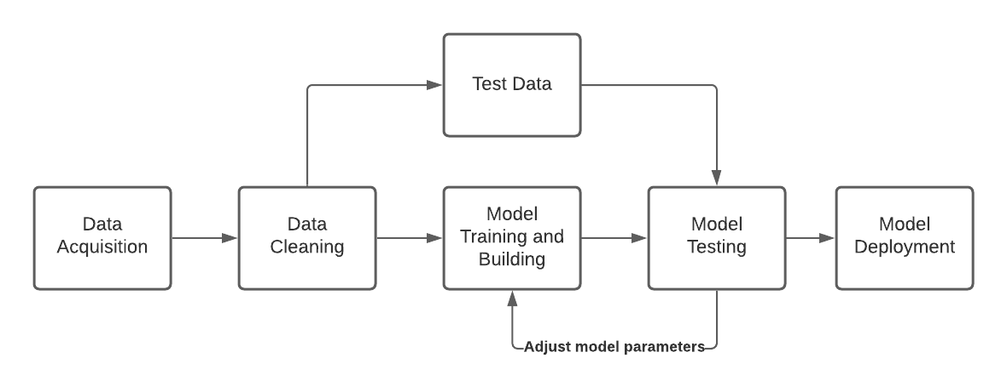
Steps Followed

Slide 7
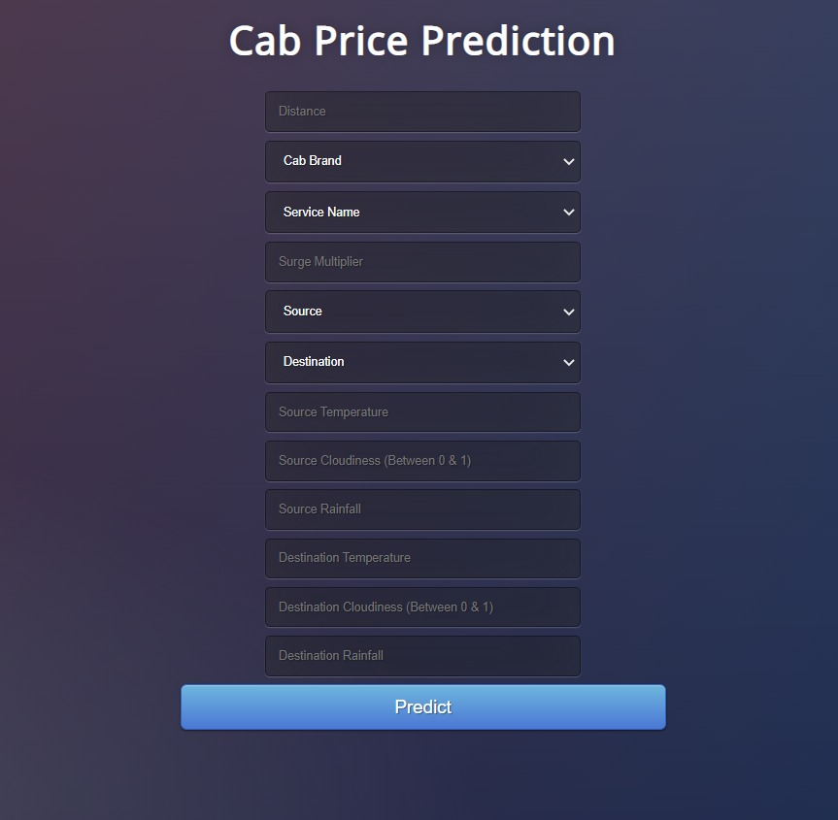
UI Output

Slide 8
THANK YOU

